Slide 1

2022
Software solution for Media Bazaar
Project made by : Andrei, Pedro, Bogdan & Piotr

Slide 2
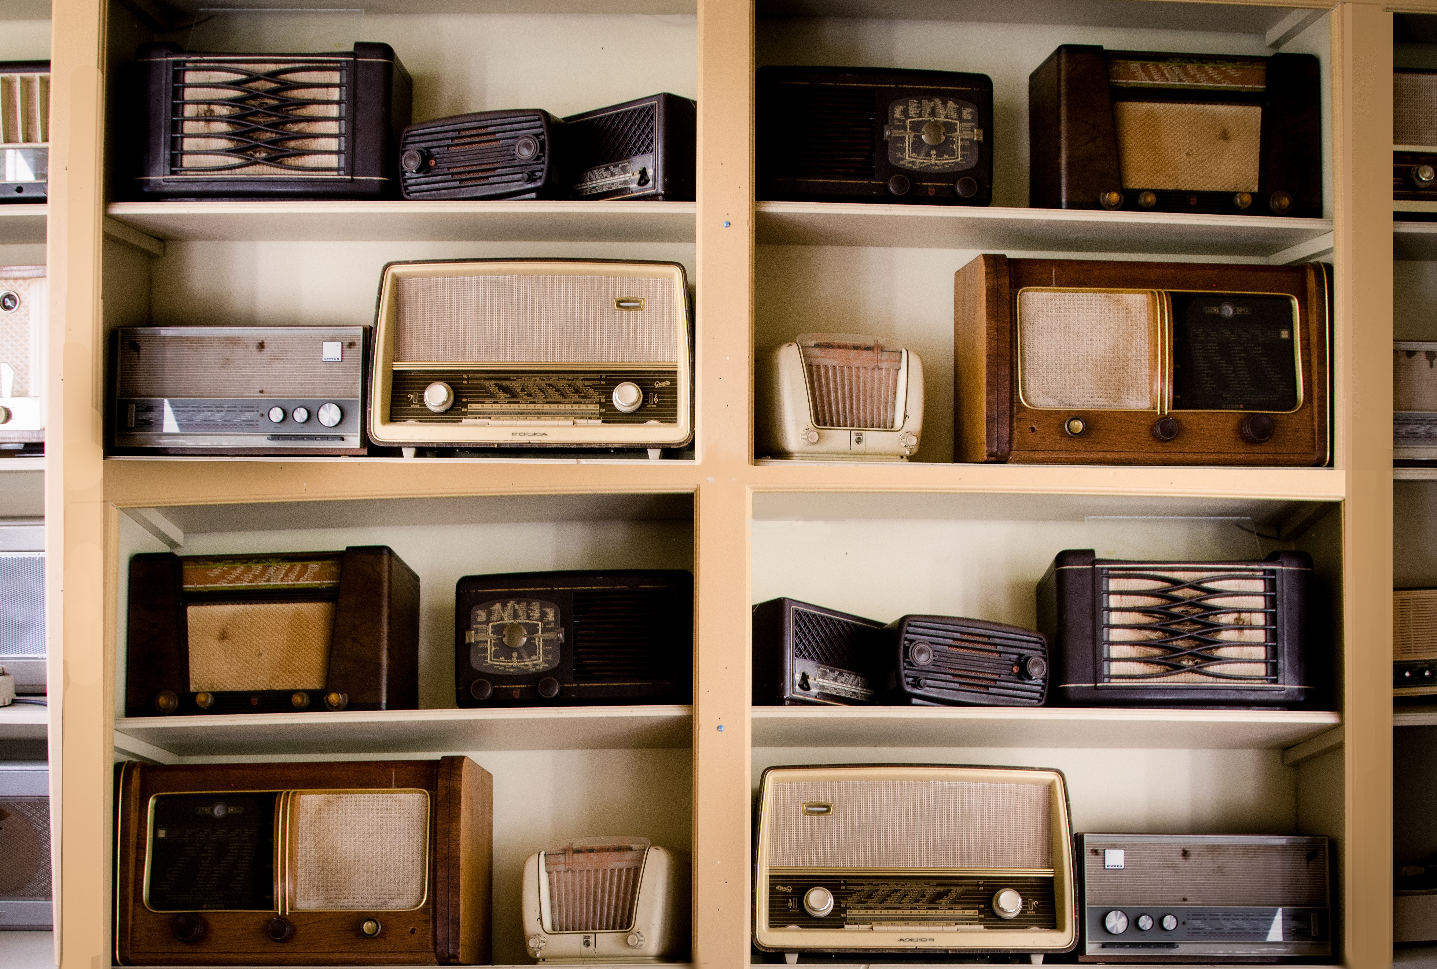
Back-Story

Slide 3

Introduction
A windows forms application
Company management system
Software solution

Slide 4

App functionalities For Managers

Slide 5

App functionalities
For Employees

Slide 6




Reflection
Working in a group
Learning new concepts (OOD)
Testing & Debugging

Slide 7

QUESTIONS?

Slide 8


